Slide 1
RMC (Ready mix concrete) Management system
Project Report
Submitted by :Aryan wagh , Aditya yele , Rehan shaikh
Class : S.Y.BSC(CS) ROLL NO :302,304,285
Acedemic year : 2026-2027

Slide 2
Introduction
The RMC (Ready Mix Concrete) Management System is a software application designed to automate the daily operations of an RMC business. It manages customer orders, production, delivery, vehicles, billing, and inventory.
The system reduces manual work, saves time, minimizes errors, and stores business information digitally. It also generates reports for sales, deliveries, and stock, helping management make better decisions.
This project demonstrates the practical use of DBMS, Software Engineering, and System Design in solving real-world business problems.

Slide 3
Preliminary Investigation and its activity
This project is suitable for small and medium-sized RMC plants and serves as an excellent academic project for software engineering students. It demonstrates the practical application of database management, system analysis, software design, and user-interface development in solving real-world business problems.

Slide 4
Problem identification
Manual order paper working management leads to data entry errors and misplaced records.
Difficulty in tracking the status of customer orders and deliveries.
Poor scheduling and allocation of mixer trucks, causing delivery delays.
In accurate inventory management of raw materials such as cement, sand, aggregates, and water.
Time-consuming billing and invoice generation.
Lack of centralized data, making report generation and decision-making difficult.
Increased paperwork, resulting in higher administrative costs and reduced efficiency.
Limited communication between production, dispatch and management teams

Slide 5
Problem Definition
The existing RMC (Ready Mix concrete) management process is manual and time-consuming, leading to errors in order management, billing, inventory, and delivery scheduling. It is difficult to maintain accurate records and track customer order efficiently. The proposed RMC Management System automates these processes, reduces paperwork, improves accuracy, saves time, and provides better management of orders, inventory, deliveries and billing.

Slide 6
Fact Finding Technique
1. What is the concrete preparation process like in your RMC plant?
→ Raw materials → Batching → Mixing → Quality testing → Loading → Transportation → Site delivery.
2. What customer information is collected?
→ Customer name and contact number; Address; Project / site details; Concrete type / grade required; Order quantity; Delivery date and time; Payment details; Order history.
3. How many orders do you usually receive in a day?
→ RMC plant may receive around 10–20 orders per day.
4. How is the status of the order tracked?
→ Order Received → Confirmed → In production → Dispatch → Delivered → Completed.
5. How is an order cancelled recorded?
→ Order ID; Customer name; Cancellation date; Reason for cancellation; Cancelled by.
6. What types of concrete are available?
→ M20, M25, M30, M35 and M40 grades; Normal / standard concrete; High-strength concrete.
7. What raw materials are used to make concrete?
→ Cement, fine aggregate (sand), coarse aggregate (stone / gravel), water, and admixtures (if required).

Slide 7
Fact Finding Technique
8. How is the quality of concrete checked?
→ Slump test – checks workability; Cube test – checks compressive strength; Material testing – checks cement, sand and aggregates.
9. What types of vehicles are used for concrete delivery?
→ Transit Mixer Trucks – transport and keep concrete mixed; Concrete Pump Trucks – pump concrete to higher or difficult locations; Tipper / Dumper Trucks – mainly used for transporting raw materials like aggregates.
10. What is the capacity of each vehicle?
→ Transit Mixer: 6–10 m³ concrete; Concrete Pump: 30–100 m³/hour; Tipper / Dumper: 10–25 tonnes of raw materials.
11. How do you track which vehicle has been sent to which customer?
→ Order ID → Customer → Vehicle number → Driver → Dispatch time → Delivery status.
12. How is the payment taken from the customer?
→ Cash; UPI / online payment; Cheque.
13. How is pending payment information maintained?
→ Customer → Invoice / Order ID → Total Amount → Paid Amount → Pending Amount → Due Date → Payment Status.
14. How is a bill / invoice given to the customer?
→ Order details → Invoice generated → Printed → Given to customer.

Slide 8
Drawback of Existing system
Manual record-keeping is time-consuming.
High chances of human errors and duplicate entries.
Difficulty in tracking customer orders and deliveries.
Poor inventory management of raw materials.
Billing and invoice generation take more time.
Increased paperwork and storage requirements.
Reports are difficult to generate and analyze.
Poor coordination between departments, causing delays.

Slide 9
Feasibility Study
Technical Feasibility
The system can be developed using commonly available technologies such as HTML, CSS, JavaScript, PHP/Python, and MySQL. The required computers, internet/network, and database facilities are generally available in an RMC plant. Therefore, the project is technically feasible.
2. Economic Feasibility
The proposed system reduces paperwork and manual work. It helps manage customers, orders, concrete production, vehicles, invoices and payments efficiently. Using open-source software can keep development and maintenance costs low. Therefore, the system is economically feasible.
3. Operational Feasibility
Employees can use the system to enter customer details, manage orders, track delivery vehicles, maintain payment records, and generate bills. It reduces errors and makes information easier to access. Therefore, the system is operationally feasible.
4. Schedule Feasibility
The system can be developed in stages such as requirement analysis, database design, coding, testing and implementation within the project schedule. Therefore, it is schedule feasible.
5. Legal Feasibility
The system should maintain customer and business information securely and follow applicable data-protection and business-record requirements. No major legal issue is expected for the proposed academic system.

Slide 10
Requirement Specification
Data Requirements of the RMC Management System
Customer Data: Customer ID, name, contact number, address.
Phone Call Order Data: Order ID, concrete type, quantity, order date, delivery date.
Inventory Data: Cement, sand, aggregates, water, stock quantity.
Vehicle Data: Truck ID, vehicle number, delivery details, availability.
Delivery Data: Delivery status, location, date and time.
Billing Data: Invoice number, payment amount, payment status.
Admin Data: Username, password, and admin role.
Staff Data: Username, password, and staff role.
Supplier Data: Supplier details. 10. Material Data: Material details.

Slide 11
End Users of the RMC Management System
Administrator: Manages the entire system, users, and reports.
Sales Executive: Creates and manages customer orders.
Production Manager: Monitors concrete production and raw materials.
Inventory Manager: Maintains stock of cement, sand, aggregates, and other materials.
Delivery Manager / Dispatcher: Schedules and tracks vehicle deliveries.
Accounts Staff: Generates invoices and records payments.

Slide 12
Functional and Non-Functional Requirements of RMC Management System
Functional Requirements
User login and authentication
Customer registration and management
Order booking and order tracking
Concrete mix design management
Vehicle and driver management
Delivery scheduling and dispatch
Inventory management (cement, sand, aggregates, water, etc.)
Billing and invoice generation
Payment recording and tracking
Reports for sales, deliveries, inventory, and payments.
Admin can manage users and system settings.

Slide 13
Non-Functional Requirements
Performance: The system should respond quickly and support multiple users.
Security: User authentication and secure data storage.
Reliability: The system should work continuously with minimal downtime.
Usability: Simple and user-friendly interface.
Scalability: System should be easily expandable to add more users, vehicles,and customers.
Availability: System should be available whenever required.
Maintainability: Easy to update and fix.
Data Backup: Regular backup to prevent data loss.
Compatibility: Should work on modern web browsers and devices.
Accuracy: Orders, inventory, and billing calculations should be correct.

Slide 14
Database Design – Entities, Relationships and Attributes
Entity | Attributes
Supplier | supplier-id, name, phone, email, address
Material | material-id, name, type, unit, price-per-unit, supplier-id
Concrete Mix | mix-id, name, grade, description
Customer | customer-id, name, phone, email, address, company-name
Order | order-id, customer-id, mix-id, admin-id, quantity, total-amount, cancelled-date
Payment | payment-id, order-id, amount, payment-date, payment-method, status
Delivery | delivery-id, order-id, vehicle-id, staff-id, dispatch id, delivery-date, status
Delivery Vehicle | vehicle-no, capacity, type
Staff | staff-id, name, role, phone, email, joining-date
Admin | admin-id, name, email, phone, username, password
Invoice | invoice-id, order-id, payment-id, invoice-date, amount, tax, total-amount, pdf-path
Cancelled Order | cancel-id, order-id, cancel-reason, cancelled-date

Slide 15
Relationships Between Tables / Entities
Entity 1 | Relationship | Entity 2 | Cardinality
Supplier | supplies | Material | 1:M
Customer | places | Order | 1:M
Concrete Mix | used in | Order Order | 1:M
Order | has | Payment | 1:M
Admin | manages | Order | 1:M
Admin | manages | Staff | 1:M
Admin | creates | Invoice | 1:M
Customer | makes | Payment | 1:M
Order | has | Delivery | 1:M
Staff | handles | Delivery | 1:M
Delivery Vehicle | used for | Delivery | 1:M
Order | has | Invoice | 1:1
Order | may have | Cancelled Order | 1:1
Material | used in | Concrete Mix | 1:M

Slide 16
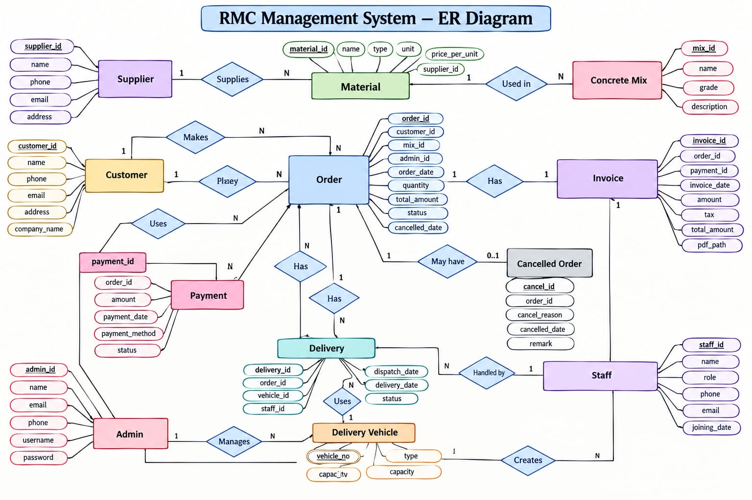

Slide 17
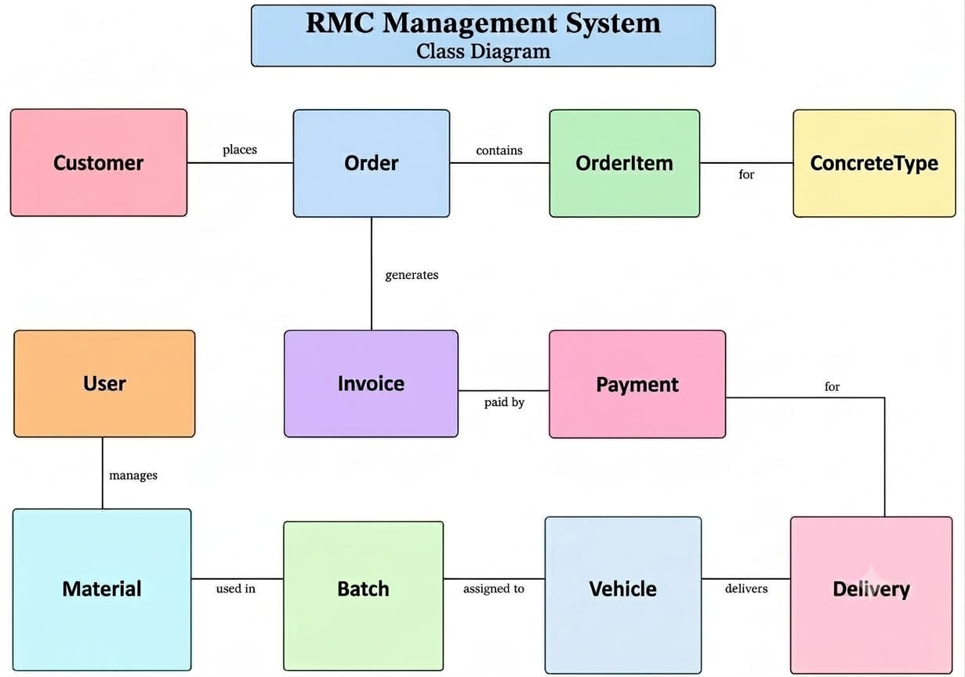

Slide 18
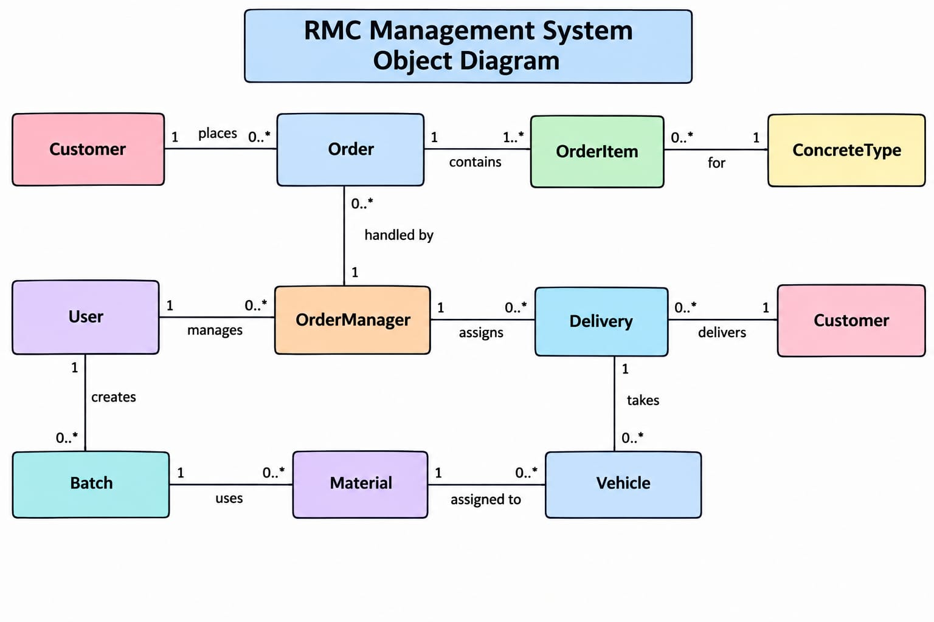

Slide 19
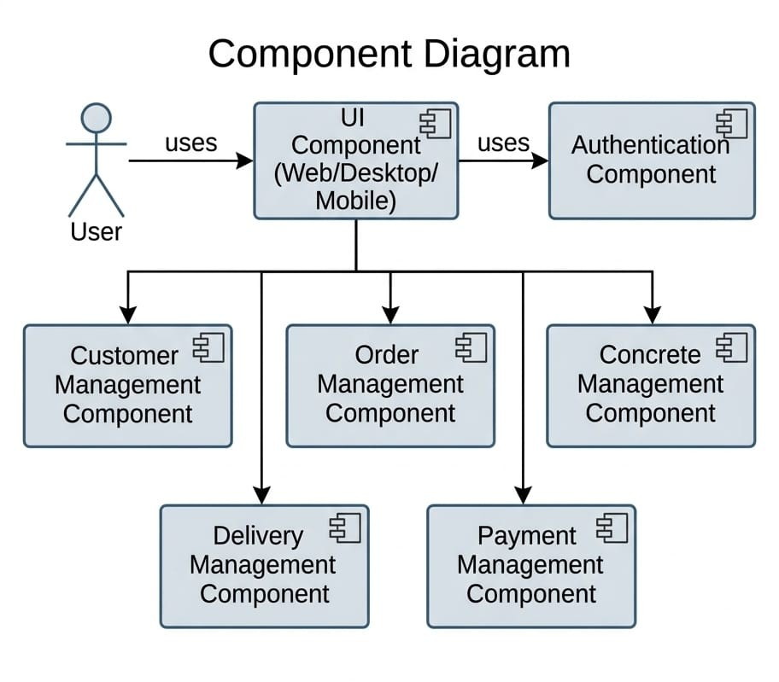

Slide 20
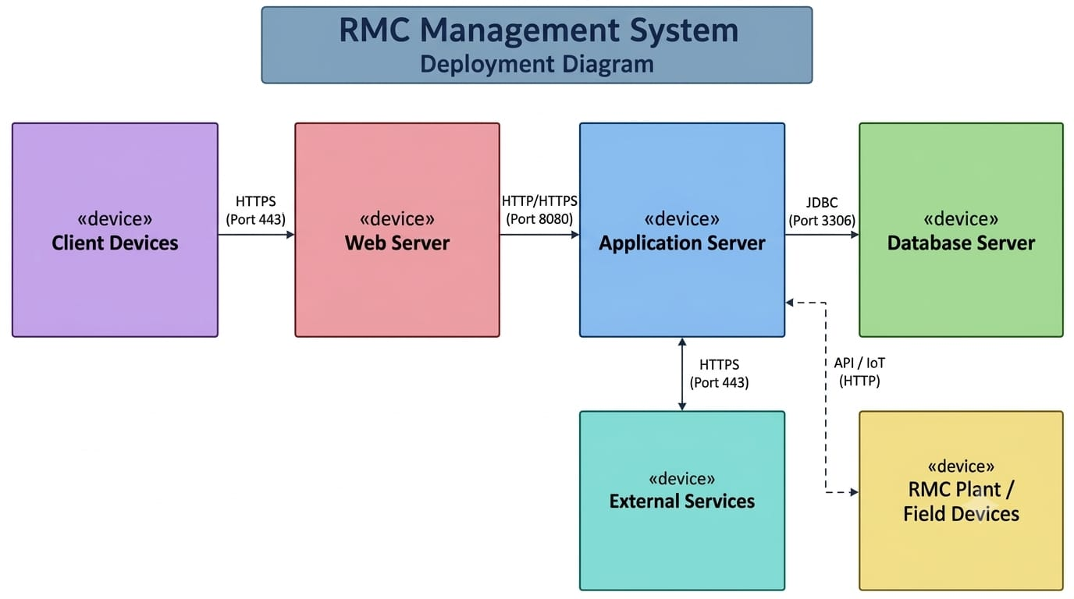

Slide 21
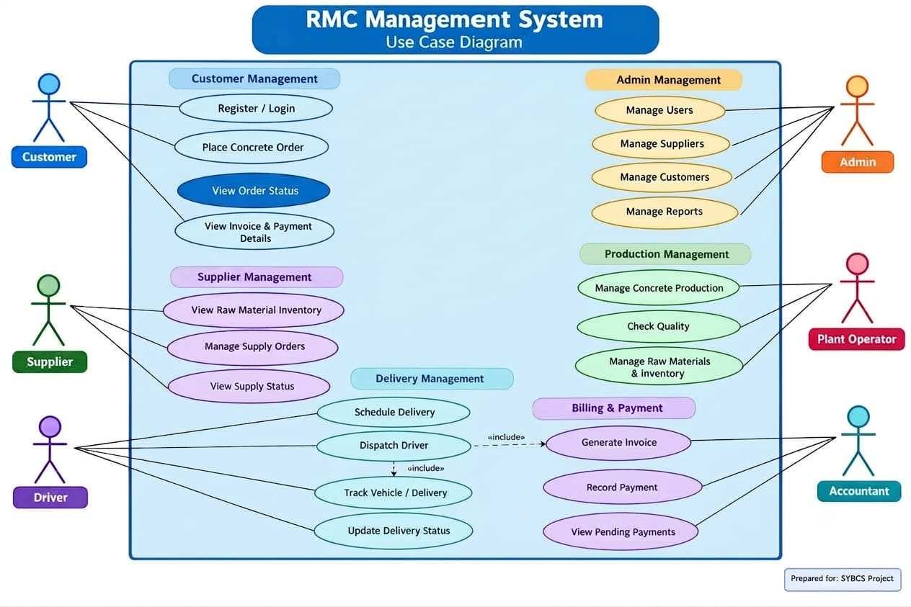

Slide 22
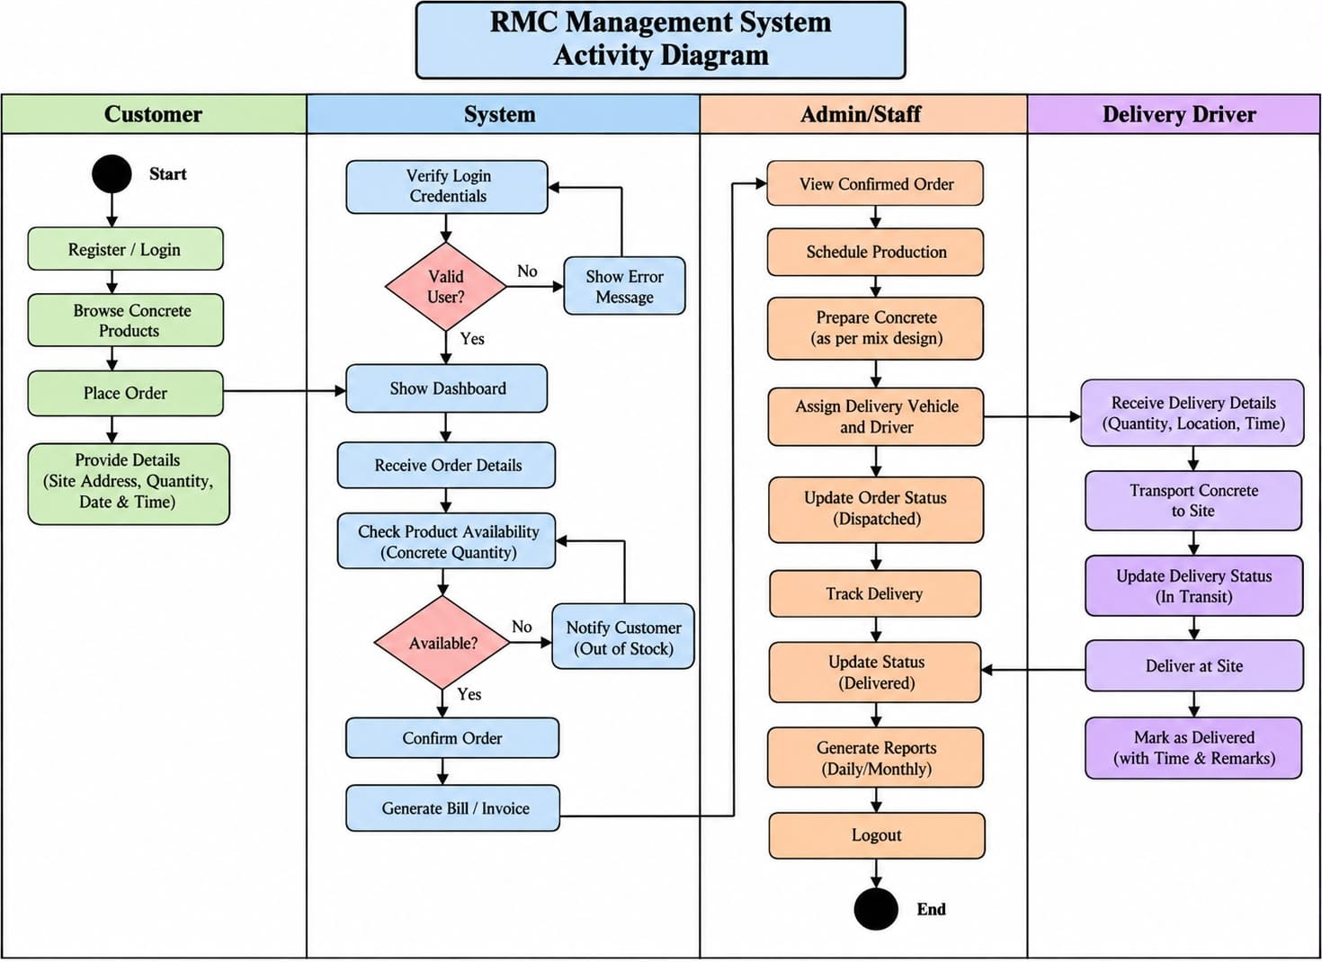

Slide 23
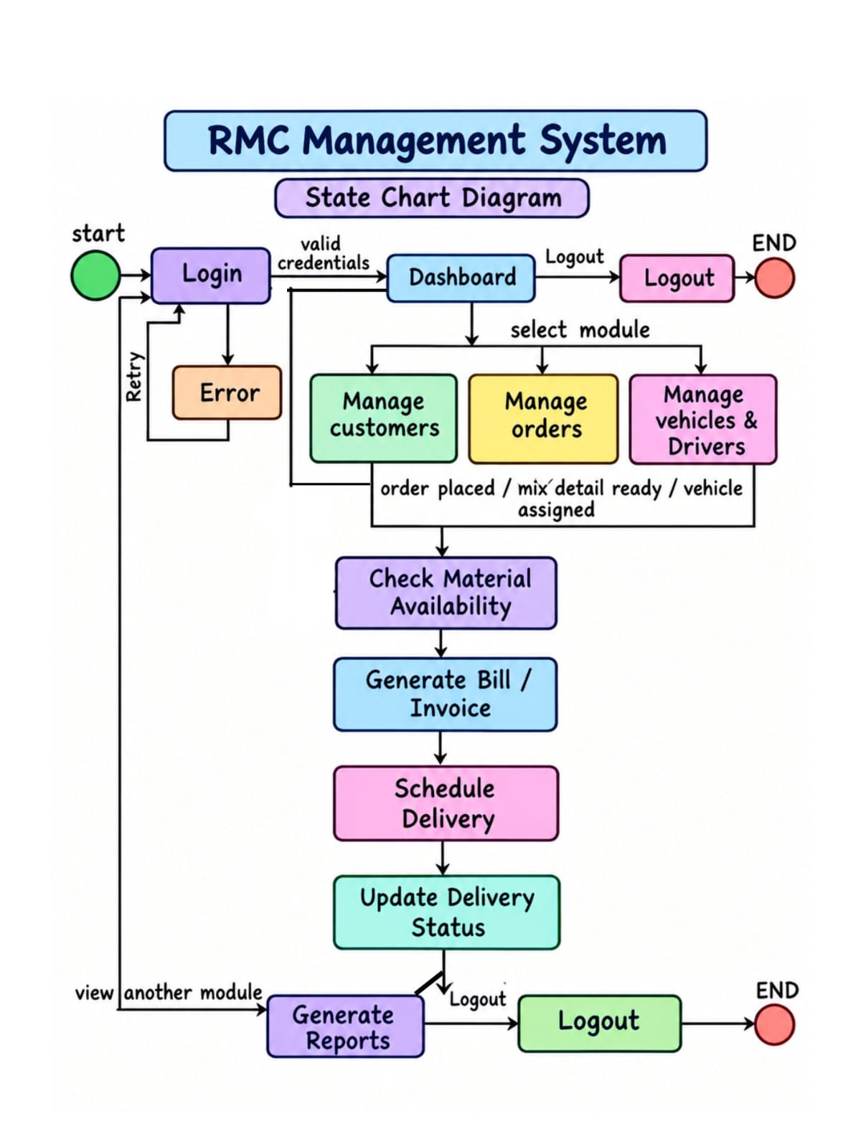

Slide 24
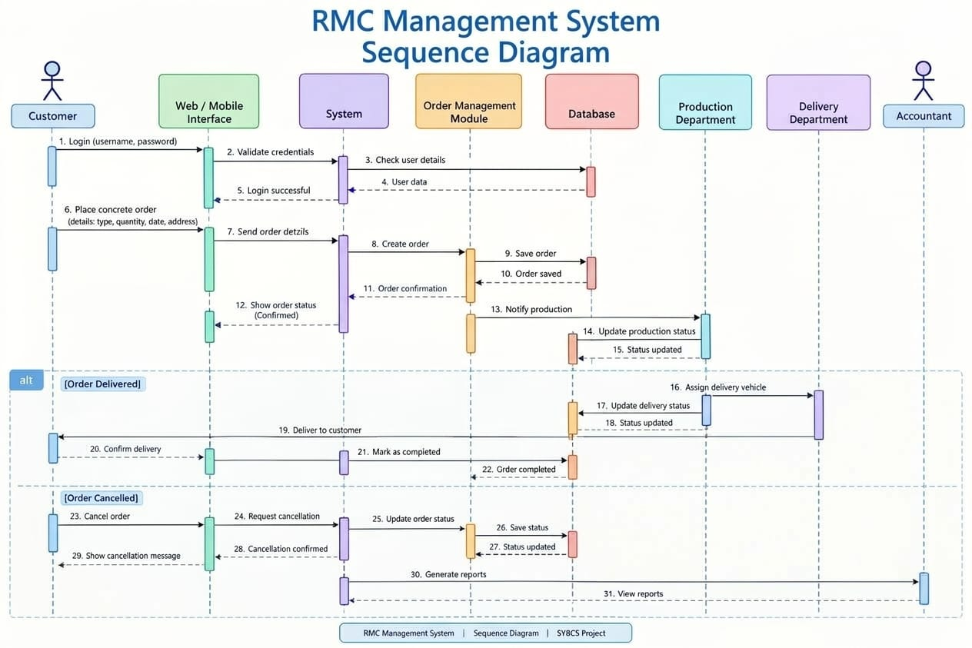

Slide 25
